Slide 1
MSAS Tutorial Sequence -Module Two-
WRITTEN BY ADVAY MUCHOOR

Slide 2

THANKS FOR COMING BACK

Slide 3
Goals of Today
Understand Some Basics Of Python
Learn to navigate Jupyter Notebook

Slide 4

Python

Slide 5
Background and Info
Python is a popular programming language that was released in 1991
Designed for readability and simplicity
Has wide variety of uses and packages
We will be using Python for our data manipulation
Python vs. C++
Similar syntaxes
No typecasting in Python
No semicolons in Python
Uses white space to define scope (not brackets)

Slide 6
Variables in Python
Variables are containers for storing data values.
Unlike other programming languages, Python has no command for declaring a variable.
You don’t have to typecast your variables at declaration
A variable is created the moment you first assign a value to it.
Initialize a variable using the following format: name = value
Examples:
x = 5 (x is now an integer)
y = “Advay” (y is now a string)
x = “Michigan” (x is now a string – the types can change after declaration)
average_points = 23.4 (average_points is now a “float”/decimal)

Slide 7
Notes about variables in Python
Integers and Decimals can be positive or negative.
Strings can be surrounded by single or double quotes (but not a mixture)
Any variable can be outputted using the print command
x = 5
print(x) This will output 5
You can use other variables to create new variables
x = 5
y = 10
z = x + y
print(z) This will output 15

Slide 8
Variable types
You can get the data type of any object by using the type() function
Useful when we get into more advanced variable types
Example
x = 5
print(type(x)) <class ‘int’>
The type of a variable can be changed really simply through casting
x = 5
y = str(x)
print(type(y)) <class ‘str’>
Be careful, as casting in the opposite direction will cause an error unless the string only contains numeric characters

Slide 9
Literals vs Variables
A literal is the literal value of something
Literals are useful when we don’t want to store a piece of data in a variable
Examples
x = 3
y = x + 5
print(y) 8
print (3 + 5) 8
print(“hello world”) hello world

Slide 10
Operators
Basic shared operator for integers and floats
Addition (+)
Subtraction (-)
Multiplication (*)
Exponents (**)
Basic operators for strings
Addition (+)
x = “Python is ”
y = “cool”
print (x + y) 🡪 “Python is cool”
CANNOT USE “+” OPERATOR ON OPERANDS WITH DIFFERENT TYPES
print(“Advay” + 5) 🡪 Error
print(“Advay” + str(5)) 🡪 Advay5

Slide 11

Jupyter Notebooks

Slide 12
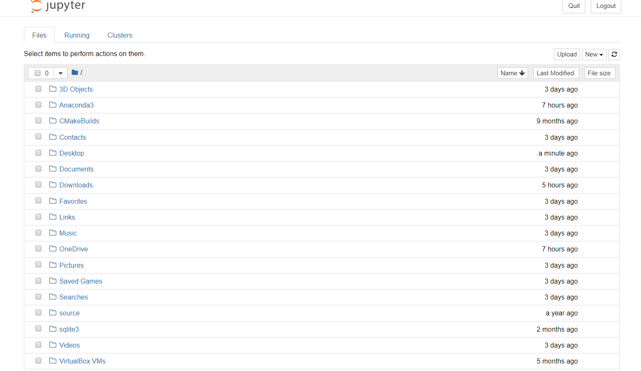
Dashboard

Slide 13
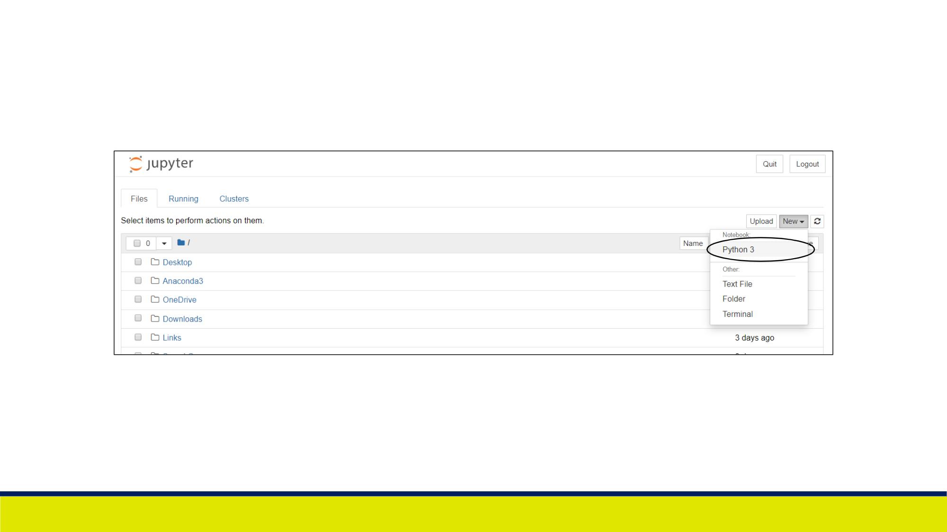

Slide 14
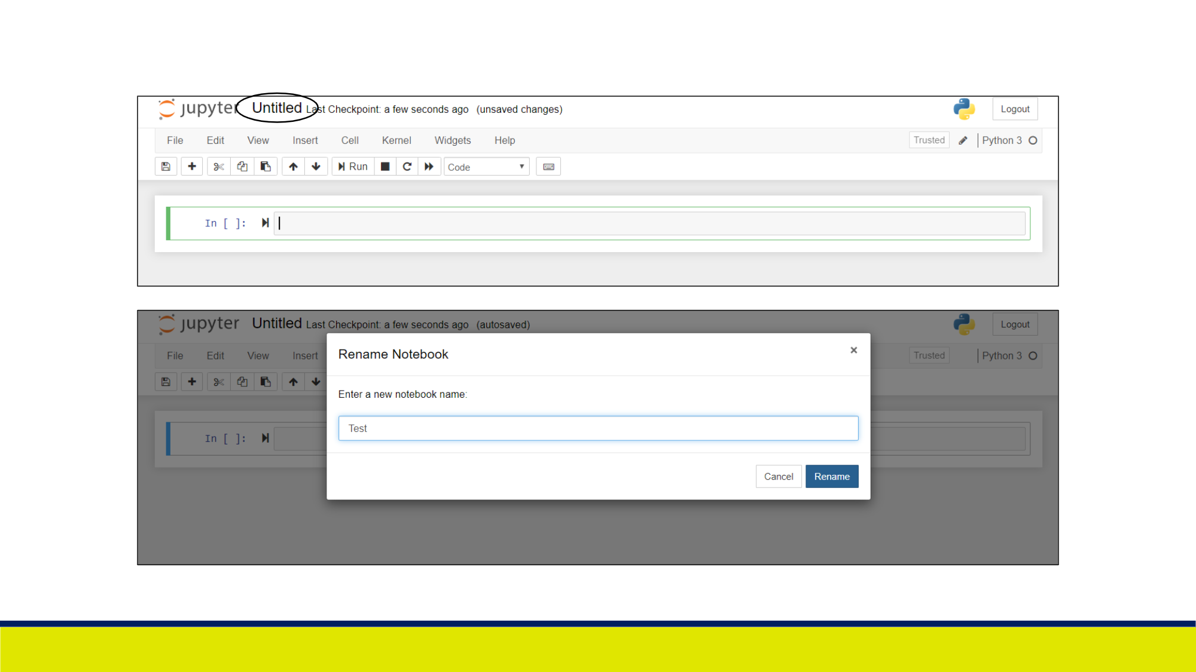

Slide 15
Understanding The Kernel
Each cell contains code in it
The kernel is a collection of cells
The cells in the kernel are connected to each other
When the entire kernel is run, cells run top to bottom
Cells can “talk” to each other
A cell can use variables that were defined in another cell
Variable MUST be defined before being used
Cells can be run individually, or as a whole

Slide 16

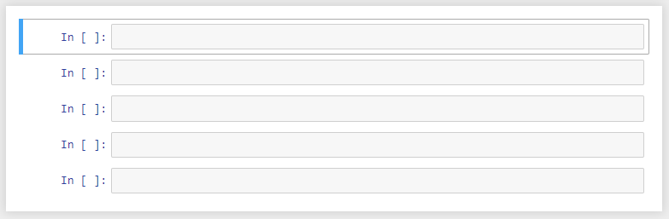
Cell
Blue cell 🡪 Command mode (controlling the kernel)
Green cell 🡪 Active mode (writing code)
Kernel

Slide 17

Basic Commands
Running a cell (Active and Command)
CTRL + ENTER / COMMAND + ENTER
Inserting a cell Below (Command)
b key
Inserting a cell Above (Command)
a key
Deleting your current cell (Command)
d, d (d key twice)
Save the kernel
CTRL + s / COMMAND + s

Slide 18
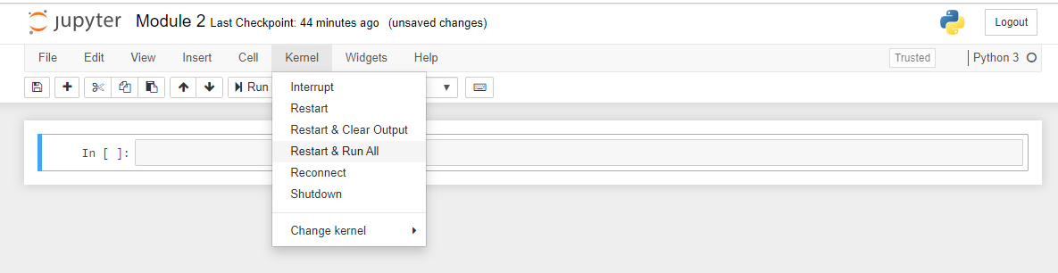
Ordering of the cells
Pay close attention to the order in which cells are run
Every time you edit a cell, you should run it
If you edit a cell and do not run it, the other cells will think that nothing has changed
It is often useful to just restart the kernel and re-run everything (will restart cell numbers at 1)
“Restart and clear output” will delete all old variables (otherwise, old variables will never die)

Slide 19
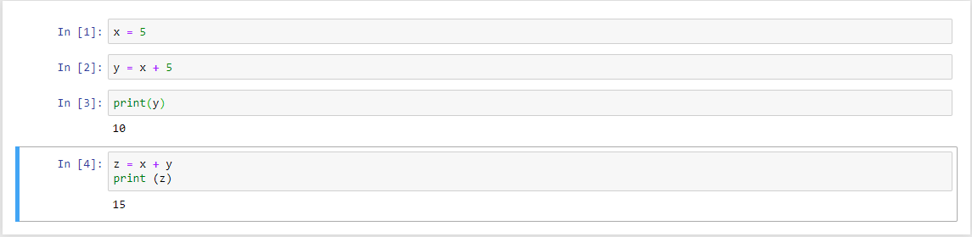

Slide 20
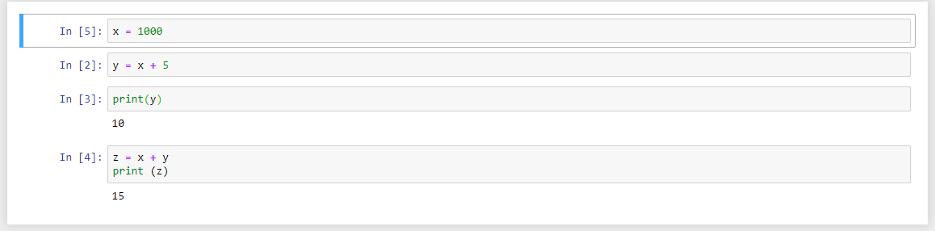

Slide 21
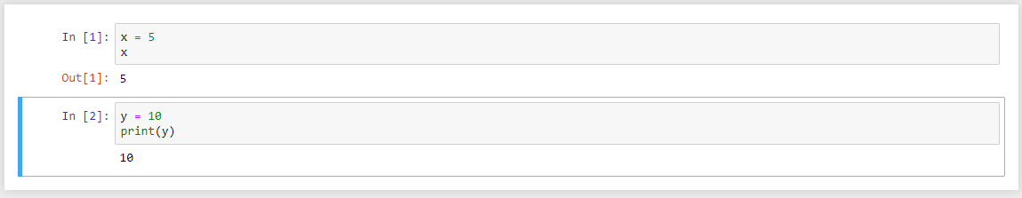
Additional Information
“Out [ ]” is the output for cell that was run
Print statements do not generate “Out [ ]” blocks, but the behavior is still the same
In jupyter notebooks, you don’t have to use print statements to get the output of a variable

Slide 22
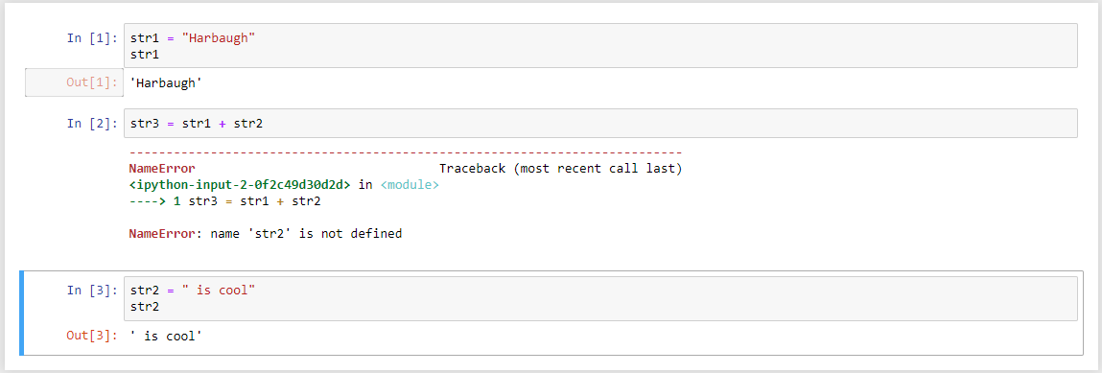
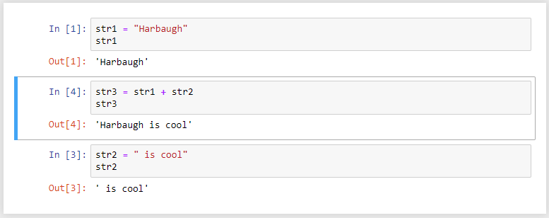

Slide 23
Take some time to play around with the environment
ASK QUESTIONS

